Slide 1

APEX INSTITUTE OF TECHNOLOGY
DEPARTMENT OF COMPUTER SCIENCE & ENGINEERING
Statistics for Data Science(23CSH-233)
Faculty: Prof. (Dr.) Madan Lal Saini(E13485)
Lecture – 17
Bernoulli Distribution
DISCOVER . LEARN . EMPOWER

Slide 2
Statistics for Data Science : Course Objectives
COURSE OBJECTIVES
The Course aims to:
To equip students with the skills to summarize and interpret data using descriptive statistics and visualization techniques.
To develop a foundational understanding of probability and its applications in data science.
To enable students to perform hypothesis testing and construct confidence intervals for statistical inference.
To teach students how to build and assess linear and logistic regression models for predictive analysis.
To provide hands-on experience with statistical software for data manipulation, analysis, and visualization.

Slide 3
COURSE OUTCOMES
On completion of this course, the students shall be able to:-
CO1 | Summarize and describe the main features of a dataset using measures such as mean, median, mode, variance, and standard deviation, as well as graphical representations like histograms, box plots, and scatter plots.
CO2 | Understand of probability theory, including concepts such as random variables, probability distributions, and the law of large numbers, enabling them to model and reason about uncertainty in data.
CO3 | Apply/perform statistical inference, including hypothesis testing, confidence interval estimation, and p-value computation, to draw valid conclusions from sample data about larger populations.
CO4 | Apply linear and logistic regression techniques to identify relationships between variables, make predictions, and evaluate model performance.
CO5 | Utilize statistical software tools to perform data analysis, including data cleaning, transformation, visualization, and implementing various statistical methods.

Slide 4
Unit-2 Syllabus
Unit-2 | Probability Distribution
Probability Distribution | Concept of Random Variable, Bernoulli Distribution, Binomial Distribution, Poisson Distribution, Normal Distribution.
Correlation and Regression | Concept and types, Karl Pearson Method, Rank, Spearman Method, Least Square Method, Regression line by regression coefficient

Slide 5
SUGGESTIVE READINGS
TEXT BOOKS:
T1. Hastie, Trevor, et al., The elements of statistical learning. Vol. 2. No. 1. New York: Publisher: Springer, Edition: Second Edition (2009), ISBN: 978-0387848570
T2. Montgomery, Douglas C., and George C. Runger. Applied statistics and probability for engineers. John Wiley & Sons, 2010.
T3. Probability and Statistics The Science of Uncertainty Second Ed., Michael J. Evans and Jeffrey S. Rosenthal.
REFERENCE BOOKS:
R1. Practical Statistics for Data Scientists: 50 Essential Concepts, Authors: Peter Bruce, et al, Publisher: O'Reilly Media, Edition: Second Edition (2020), ISBN: 978-1492072942
R2. An Introduction to Statistical Learning: with Applications in R, Authors: Gareth James, et al, Publisher: Springer, Edition: Second Edition (2021), ISBN: 978-1071614174
R3. Think Stats: Exploratory Data Analysis in Python, Author: Allen B. Downey, Publisher: O'Reilly Media, Publication Year: 2014 (2nd Edition), ISBN: 978-1491907337

Slide 6
Some Discrete Probability Distributions:
Discrete Uniform Distribution:
If the discrete random variable X assumes the values x₁, x₂, …, x_{k} with equal probabilities, then X has the discrete uniform distribution given by:
Note:
· f(x)=f(x;k)=P(X=x)
k is called the parameter of the distribution.
Example 5.2:
· Experiment: tossing a balanced die.
· Sample space: S={1,2,3,4,5,6}
· Each sample point of S occurs with the same probability 1/6.
· Let X= the number observed when tossing a balanced die.
The probability distribution of X is:

Slide 7
Theorem 5.1:
If the discrete random variable X has a discrete uniform distribution with parameter k, then the mean and the variance of X are:
Var(X) = σ² =

Slide 8
Example 5.3:
Find E(X) and Var(X) in Example 5.2.
Solution:
E(X) = μ =
Var(X) = σ² =

Slide 9
5.3 Binomial Distribution:
Bernoulli Trial:
· Bernoulli trial is an experiment with only two possible outcomes.
· The two possible outcomes are labeled:
success (s) and failure (f)
· The probability of success is P(s)=p and the probability of failure is P(f)= q = 1−p.
· Examples:
1. Tossing a coin (success=H, failure=T, and p=P(H))
2. Inspecting an item (success=defective, failure=non- defective, and p=P(defective))

Slide 10
Bernoulli Process:
Bernoulli process is an experiment that must satisfy the following properties:
1. The experiment consists of n repeated Bernoulli trials.
2. The probability of success, P(s)=p, remains constant from trial to trial.
3. The repeated trials are independent; that is the outcome of one trial has no effect on the outcome of any other trial
Binomial Random Variable:
Consider the random variable :
X = The number of successes in the n trials in a Bernoulli
process
The random variable X has a binomial distribution with parameters n (number of trials) and p (probability of success), and we write:
X ~ Binomial(n,p) or X~b(x;n,p)

Slide 11
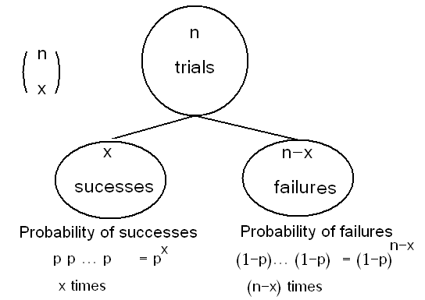
The probability distribution of X is given by:

Slide 12
We can write the probability distribution of X as a table as follows.
x | f(x)=P(X=x)=b(x;n,p)
0
1
2
n − 1
n
Total | 1.00

Slide 13
Example:
Suppose that 25% of the products of a manufacturing process are defective. Three items are selected at random, inspected, and classified as defective (D) or non-defective (N). Find the probability distribution of the number of defective items.
Solution:
· Experiment: selecting 3 items at random, inspected, and classified as (D) or (N).
· The sample space is
S={DDD,DDN,DND,DNN,NDD,NDN,NND,NNN}
· Let X = the number of defective items in the sample
· We need to find the probability distribution of X.

Slide 14
(1) First Solution:
Outcome | Probability | X
NNN |  | 0
NND |  | 1
NDN |  | 1
NDD |  | 2
DNN |  | 1
DND |  | 2
DDN |  | 2
DDD |  | 3

Slide 15
The probability distribution
.of X is
x | f(x)=P(X=x)
0
1
2
3
(2) Second Solution:
Bernoulli trial is the process of inspecting the item. The results are success=D or failure=N, with probability of success P(s)=25/100=1/4=0.25.
The experiments is a Bernoulli process with:

Slide 16
· number of trials: n=3
· Probability of success: p=1/4=0.25
· X ~ Binomial(n,p)=Binomial(3,1/4)
· The probability distribution of X is given by:
The probability distribution of X is
x | f(x)=P(X=x) =b(x;3,1/4)
0 | 27/64
1 | 27/64
2 | 9/64
3 | 1/64

Slide 17
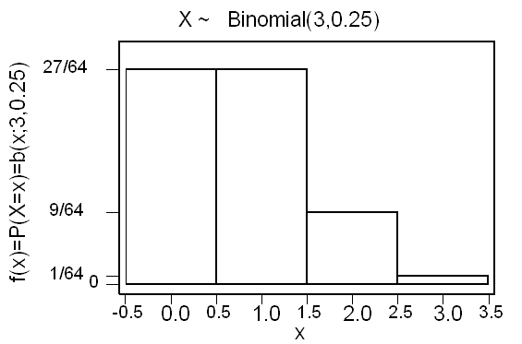
Theorem 5.2:
The mean and the variance of the binomial distribution b(x;n,p) are:
μ = n p
σ² = n p (1 −p)

Slide 18
Example:
In the previous example, find the expected value (mean) and the variance of the number of defective items.
Solution:
· X = number of defective items
· We need to find E(X)=μ and Var(X)=σ²
· We found that X ~ Binomial(n,p)=Binomial(3,1/4)
· .n=3 and p=1/4
The expected number of defective items is
E(X)=μ = n p = (3) (1/4) = 3/4 = 0.75
The variance of the number of defective items is
Var(X)=σ² = n p (1 −p) = (3) (1/4) (3/4) = 9/16 = 0.5625

Slide 19
Example:
In the previous example, find the following probabilities:
(1) The probability of getting at least two defective items.
(2) The probability of getting at most two defective items.
Solution:
X ~ Binomial(3,1/4)
x | .f(x)=P(X=x)=b(x;3,1/4)
0 | 27/64
1 | 27/64
2 | 9/64
3 | 1/64

Slide 20
The probability of getting at least two defective items:
P(X≥2)=P(X=2)+P(X=3)= f(2)+f(3)=
(2) The probability of getting at most two defective item:
P(X≤2) = P(X=0)+P(X=1)+P(X=2)
= f(0)+f(1)+f(2) =
or
P(X≤2)= 1−P(X>2) = 1−P(X=3) = 1− f(3) =
Example 5.4: Reading assignment
Example 5.5: Reading assignment
Example 5.6: Reading assignment

Slide 21
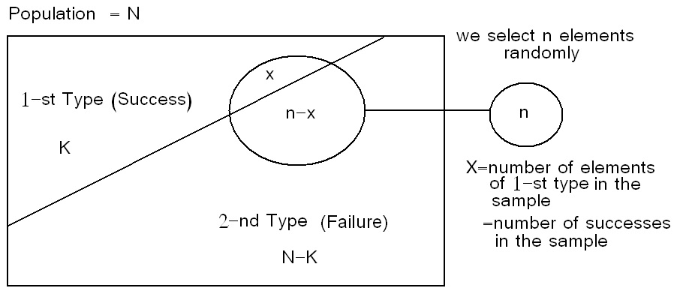
5.4 Hypergeometric Distribution :
· Suppose there is a population with 2 types of elements:
1-st Type = success
2-nd Type = failure
· N= population size
· K= number of elements of the 1-st type
· N −K = number of elements of the 2-nd type

Slide 22
· We select a sample of n elements at random from the population
· Let X = number of elements of 1-st type (number of successes) in the sample
· We need to find the probability distribution of X.
There are to two methods of selection:
1. selection with replacement
2. selection without replacement
(1) If we select the elements of the sample at random and with replacement, then
X ~ Binomial(n,p); where
(2) Now, suppose we select the elements of the sample at random and without replacement. When the selection is made without replacement, the random variable X has a hyper geometric distribution with parameters N, n, and K. and we write X~h(x;N,n,K).

Slide 23
Note that the values of X must satisfy:
0≤x≤K and 0≤n−x≤ N−K
⇔
0≤x≤K and n−N+K≤ x≤ n
Example 5.8: Reading assignment

Slide 24
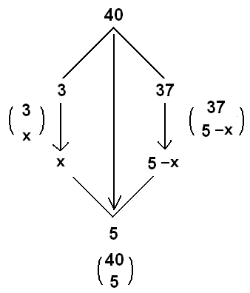
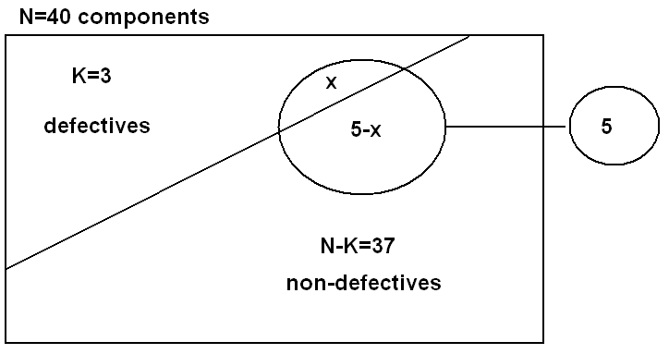
Example 5.9:
Lots of 40 components each are called acceptable if they contain no more than 3 defectives. The procedure for sampling the lot is to select 5 components at random (without replacement) and to reject the lot if a defective is found. What is the probability that exactly one defective is found in the sample if there are 3 defectives in the entire lot.
Solution:

Slide 25
· Let X= number of defectives in the sample
· N=40, K=3, and n=5
· X has a hypergeometric distribution with parameters N=40, n=5, and K=3.
· X~h(x;N,n,K)=h(x;40,5,3).
· The probability distribution of X is given by:
But the values of X must satisfy:
0≤x≤K and n−N+K≤ x≤ n ⇔ 0≤x≤3 and −42≤ x≤ 5
Therefore, the probability distribution of X is given by:

Slide 26
Now, the probability that exactly one defective is found in the sample is
.f(1)=P(X=1)=h(1;40,5,3)=

Slide 27
References
Books:
Hastie, Trevor, et al., The elements of statistical learning. Vol. 2. No. 1. New York: Publisher: Springer, Edition: Second Edition (2009), ISBN: 978-0387848570
Practical Statistics for Data Scientists: 50 Essential Concepts, Authors: Peter Bruce, et al, Publisher: O'Reilly Media, Edition: Second Edition (2020), ISBN: 978-1492072942
Research Papers:
Carmichael, Iain, and J. S. Marron. "Data science vs. statistics: two cultures?." Japanese Journal of Statistics and Data Science 1.1 (2018): 117-138.
Hardin, Johanna, et al. "Data science in statistics curricula: Preparing students to “think with data”." The American Statistician 69.4 (2015): 343-353.
Websites:
https://365datascience.com/resources-center/course-notes/statistics/
https://www.geeksforgeeks.org/7-basic-statistics-concepts-for-data-science/
Videos:
https://www.youtube.com/playlist?list=PLZ2ps__7DhBYrMs3zybOqr1DzMFCX49xG

Slide 28
THANK YOU
For queries
Email: madan.e13485@cumail.in

